Slide 1
Усъвършенствани API-та с ASP.NET Core 3
by Nikolay Dermendzhiev
Software Developer @ ZingaSoft
Leader @ .NET Bulgaria

Slide 2
Agenda
Worker Service & Worker SDK
HTTP/2
gRPC
SignalR
Generic Host
New JSON serialization
Health Checks
More…

Slide 3
Roadmap
.NET Core 3.0.x (servicing)
Maintenance. Approximately every 1-2 months or as needed.
.NET Core 3.1.x (servicing)
LTS (Long Term Support) release.
.NET 5.0
Release scheduled for November 2020
.NET 6.0
LTS (Long Term Support) release, scheduled for November 2021

Slide 4
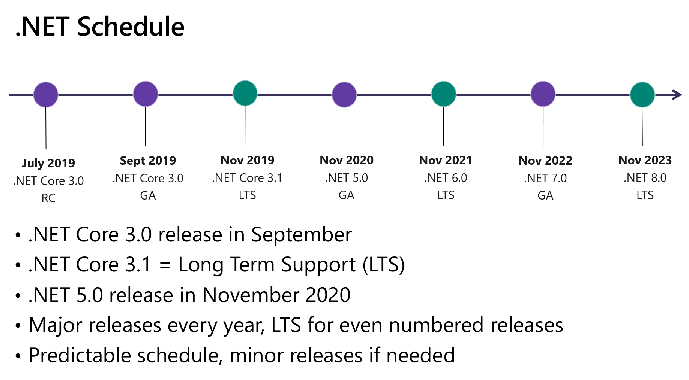
Roadmap

Slide 5
Blazor

Slide 6
Worker Service and Worker SDK

Slide 7
What is Worker Service and Worker Service SDK?
New app template
Long running services in .NET Core
Run as a Windows Service using Microsoft.Extensions.Hosting.WindowsServices
Background tasks in ASP.NET Core using hosted service

Slide 8
DEMO

Slide 9
HTTP/2 enabled by default
https://imagekit.io/demo/http2-vs-http1/

Slide 10
gRPC

Slide 11
What is gRPC?
High-performance RPC (remote procedure call) framework
Contract-first approach
Generates client and server code
Cross platform
Supports unary, client-streaming, server-streaming and bi-streaming operations
Binary
Protocol Buffers as the IDL (interface description language)
Industry standard for inter-service communication

Slide 12
gRPC in ASP.NET Core
gRPC in ASP.NET Core 3.0 includes:
Grpc.AspNetCore
Grpc.Net.Client
Grpc.Net.ClientFactory

Slide 13
DEMO

Slide 14
SignalR

Slide 15
What is SignalR?
Real-time web functionality
Server code push content to clients
Uses WebSocket transport
can fallback to older transports

Slide 16
What’s new in SignalR?
Now uses System.Text.Json to serialize/deserialize JSON messages
Automatic reconnection
.WithAutomaticReconnect([])
Customizable SignalR Hub Method Authorization

Slide 17
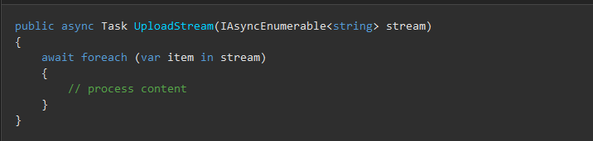
What’s new in SignalR?
Client-to-server streaming

Slide 18
DEMO

Slide 19
Generic Host

Slide 20
Generic Host
The ASP.NET Core 3.0 templates use .NET Generic Host.
Previous versions used WebHostBuilder.
IWebHostBuilder remains in 3.0, but will be deprecated
Note that this comes with a breaking change.

Slide 21
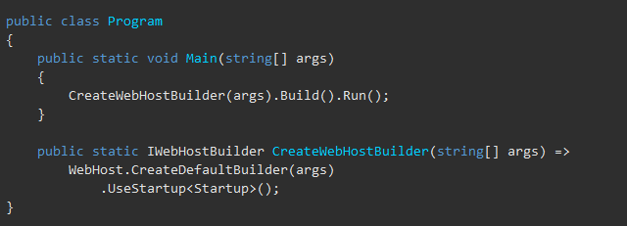
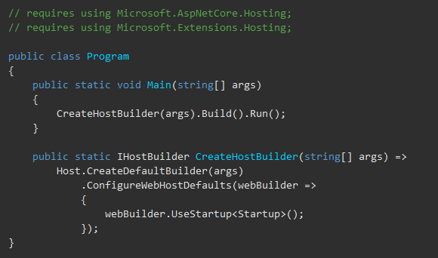
Generic Host

Slide 22
New JSON serialization

Slide 23
DEMO

Slide 24
Health Checks

Slide 25
Health Checks
Health checks are exposed by an app as HTTP endpoints
Used with an external monitoring service or container orchestrator
Statuses
Healthy
Degraded
Unhealthy

Slide 26
DEMO

Slide 27
Worth mentioning
Performance improvements
Assemblies removed from the ASP.NET Core shared framework
Newtonsoft.Json
Entity Framework Core
Certificate authentication

Slide 28
Worth mentioning
New EventCounters
requests-per-second
total-requests
current-requests
failed-requests
System.IO.Pipelines on HttpContext
New Razor directives
@attribute
@implements
There is even more…

Slide 29
Recap
Worker Service & Worker SDK
HTTP/2
gRPC
SignalR
Generic Host
New JSON serialization
Health Checks
More…

Slide 30

Questions
http://bit.ly/nikolay-linkedin

Slide 31
Resources
What's new in ASP.NET Core 3.0
What's new in ASP.NET Core 3.1
Migrate from ASP.NET Core 2.2 to 3.0
Hidden gems in .NET Core 3 - David Fowler & Damian Edwards

Slide 32

Rate my talk
http://bit.ly/survey-dotnetbg-api

